Slide 1

Traffic Volume Prediction
Presented by
Navid Imran
Hosneara Ahmed

Slide 2
Outline
Motivation
Goals
Data Analysis
Data Cleaning and preparation
Current methods
Our Design
Technical Challenges
Results
Conclusion

Slide 3
Motivation
Traffic congestion is an important and long-standing problem in transportation
It is estimated that 600 billion USD can be annually saved by avoiding congestion [1]
Traffic forecasting/prediction is key for efficient route planning and avoidance of congestion
[1] http://www.nytimes.com/2011/05/13/technology/13data.html. last visited November 1, 2021.

Slide 4
Goal
To predict hourly traffic flow volume based on the dataset
Evaluate the effect of environmental conditions (rain, snow etc.) and time of day on traffic volume forecasting

Slide 5
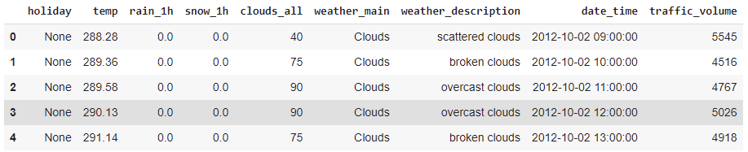
Data Description
Metro Interstate Traffic Volume
Hourly traffic volume along with weather and holiday features from 2012-2018
48204 hourly instances of 9 attributes including traffic volume

Slide 6
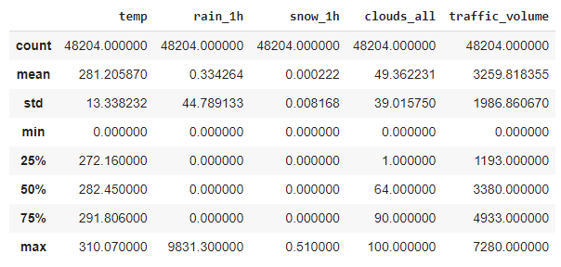
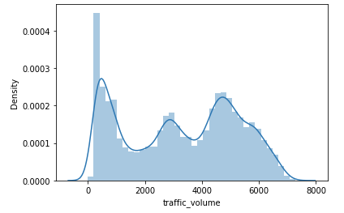
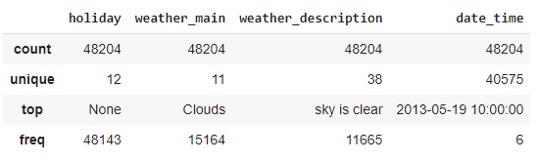
Data Analysis

Slide 7
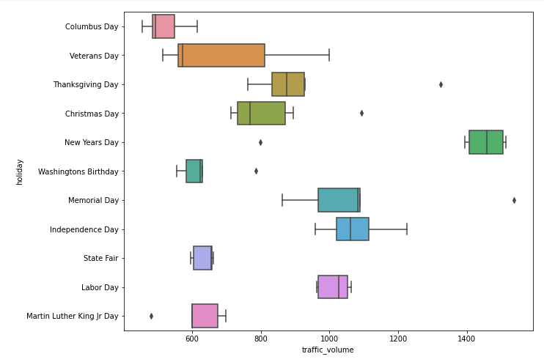
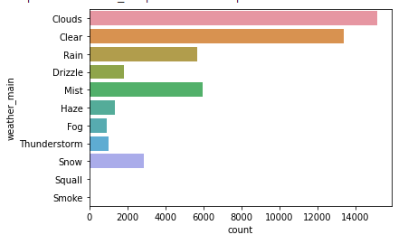
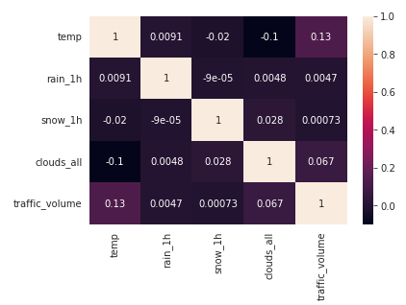
Data Analysis (cont.)

Slide 8
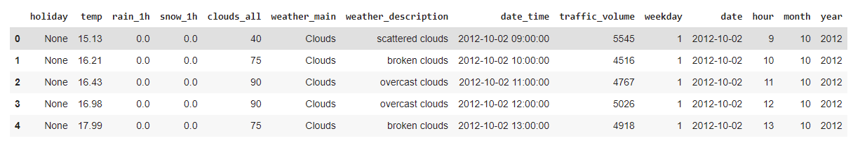
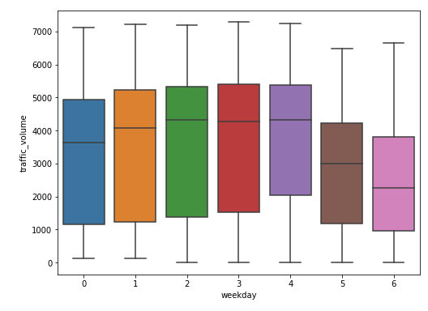
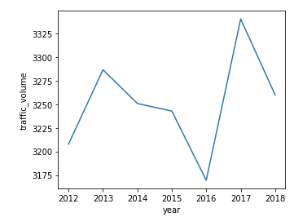
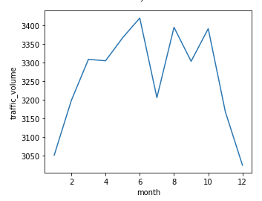
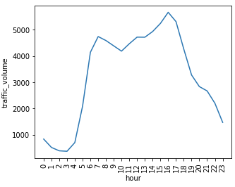
Data Preparation

Slide 9
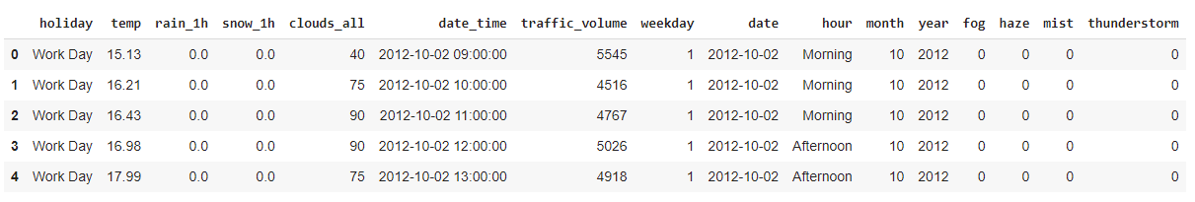
Feature Engineering
Rain_1h: No_rain, light, moderate, heavy
Snow_1h: snow, no_snow
Fog, haze, mist, thunderstorm: binary (0/1)

Slide 10
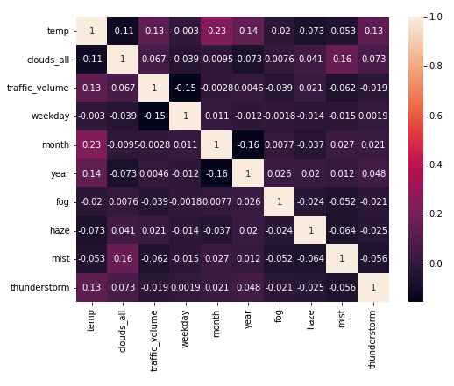
Feature Engineering (cont.)

Slide 11
Current methods
Decision tree (DT)
A system was developed for detecting traffic flow time slots using K-means for clustering and DT for prediction [2].
A DT based on C4.5 algorithm was developed in Weka to predict traffic volume in three classes, namely ‘small’, ‘medium’ and ‘large’ [3]
K-nearest neighbor (KNN)
The KNN method was applied on the traffic dataset for traffic volume forecasting [3]
[2] Muntean, Maria Viorela. "Identifying Critical Traffic Flow Time Slots Using K-Means and Decision Trees." 2020 IEEE 10th International Conference on Intelligent Systems (IS). IEEE, 2020.
[3] Khiewwan, Kanokwan, et al. "Application of Data Mining Techniques for Classification of Traffic Affecting Environments." Journal of Renewable Energy and Smart Grid Technology 15.1 (2020).

Slide 12
Current methods
Random Forest
A system
Gradient Boosting
The
[2] Muntean, Maria Viorela. "Identifying Critical Traffic Flow Time Slots Using K-Means and Decision Trees." 2020 IEEE 10th International Conference on Intelligent Systems (IS). IEEE, 2020.
[3] Khiewwan, Kanokwan, et al. "Application of Data Mining Techniques for Classification of Traffic Affecting Environments." Journal of Renewable Energy and Smart Grid Technology 15.1 (2020).

Slide 13
Current methods (cont’d)
ARIMA (AutoRegressive Integrated Moving Average)
A hybrid forecasting model H-ARIMA was proposed to use recent traffic data to estimate future traffic condition
An ensemble method was used using ARIMA-based models on random subsamples of data to improve prediction accuracy of traffic volume [5]
[4] Pan, Bei, Ugur Demiryurek, and Cyrus Shahabi. "Utilizing real-world transportation data for accurate traffic prediction." 2012 IEEE 12th International Conference on Data Mining. IEEE, 2012.
[5] Shahriari, Siroos, et al. "Ensemble of ARIMA: combining parametric and bootstrapping technique for traffic flow prediction." Transportmetrica A: Transport Science 16.3 (2020): 1552-1573.

Slide 14
Current methods (cont’d)
Neural Networks
A recurrent neural network (RNN) and Long short-term memory (LSTM) was implemented using Pytorch for the traffic dataset and an RMSE of 320.09 was achieved using the RNN [6].
A deep LSTM was used to project peak-hour traffic volume and other unique characteristics. 2 hidden LSTM layers and RMSProp optimizer was used to train the model [7].
A spatio-temporal framework based on Convolutional RNN was introduced to estimate traffic flow speed [8].
[6] Zhao, J., Huang, F., Lv, J., Duan, Y., Qin, Z., Li, G., & Tian, G. (2020, November). Do rnn and lstm have long memory?. In International Conference on Machine Learning (pp. 11365-11375). PMLR.
[7] Yu, Rose, et al. "Deep learning: A generic approach for extreme condition traffic forecasting." Proceedings of the 2017 SIAM international Conference on Data Mining. Society for Industrial and Applied Mathematics, 2017.
[8] Li, Yaguang, et al. "Diffusion convolutional recurrent neural network: Data-driven traffic forecasting." arXiv preprint arXiv:1707.01926 (2017).

Slide 15
Our Design
Random Forest and Gradient Boosting technique were used
XGBoost was used for gradient boosting
Grid Search was used to find the best hyperparameter values for tuning

Slide 16
Technical Challenges
Training a large dataset requires lot of computing resources
Our lack of experience in working with large datasets
The dataset had irrelevant and noisy data points that needed to be removed

Slide 17
Results (cont’d)
Time and Space Complexity

Slide 18
Conclusion

